Slide 1



M5W11 – Database Design

Slide 2
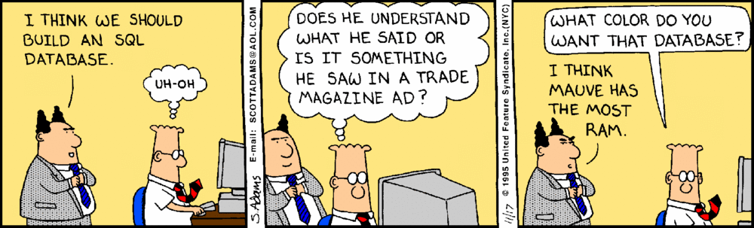
Notes:
As mentioned earlier, you will have multiple types of Database Diagrams.
To a purest you will have two main types: Conceptual ERD, and a

Slide 3

Agenda
Thinking out Loud
Introduction to Creating ERD
Data Modeling Example
Many to Many relationships
Normalized Database Design (Why and How)
Hands on:
Topics covered in deck
Creating ERD in Draw.IO
Breakout Challenge

Slide 4


Slide 5
Thinking out Loud
Setting the Table for this lecture:
Questions:
What do you think what the most important piece of any web project is?
What Makes up a Relational Database?
What Key Columns did you talk about in the last lecture?
What Data Types are you familiar with?
Notes:
Setting the Stage for this lecture.
What is the most important core piece of a web project?
Cyber Attack Review Data vs Front End
What makes up a Relational Database?
- Tables, Columns, Fields, Rows, Entities, Reords,
What Key Columns did you talk about in the last lecture?
PK – Primary Key
Expect this to be Unique
Indexed -> Data Type (int, GUID), reusability
Composite
FK – Foreign Key
Data Types
Date
Integer (used for time, money, stock exchange uses multiple integer columns (hwole and decimal parts)
Text

Slide 6
What is an ERD?
What is an ERD?
Entity-Relationship Diagram.
Components of an ERD
Entities, Attributes, Relationships, Tables, Columns, Keys
Why use ERDs?
Visualize the structure of a database making it easier to design, debug, and talk about.
Steps to create an ERD
Start with the large entities, and break down how they’ll work together.
Multiple Types of ERD
There are two main types of ERD’s you will see
Conceptual/Logical and Physical
Notes:
ERD stands for Entity-Relationship Diagram, a graphical representation of entities and their relationships.
Components include entities, attributes, and relationships.
ERDs help visualize the structure of a database, making it easier to design and debug.
Steps include identifying entities, attributes, and establishing relationships.

Slide 7
Entity Relationship Diagram – Conceptual or Logical
Terms:
Entity – The “Thing” that can have data stored about it
Relationship – How two entities relate to each other.
Attribute – Property of an Entity
**We will do a case study on the Bookshelf system shortly.
Notes:
ENTITY
An entity is a thing that can have data stored about it. It can be a physical object (e.g. car, person), a concept (e.g. address) or an event (e.g. student enrolment in a course). They represent nouns.
They are usually represented as rectangles on an ERD with the entity name inside the rectangle.
An entity can also be a strong entity or a weak entity. What’s the difference?
A strong entity has an identifier (a primary key) and does not depend on any other entities for it to exist. For example, a student may be a strong entity, as it can have a primary key and does not depend on any other entities for it to exist.
A weak entity is one that depends on a strong entity for existence. This means it has a foreign key to another entity. For example, an enrolment of a student may be a weak entity, as an enrolment cannot exist without a student.
RELATIONSHIP
A relationship in an ERD defines how two entities are related to each other. They can be derived from verbs when speaking about a database or a set of entities.
Relationships in ERDs are represented as lines between two entities, and often have a label on the line to further describe the relationship (such as “enrols”, “registers”, “completes”).
There are several types of relationships that are represented on an ERD:
One to one: One record of an entity is directly related to another record of an entity
One to many: One record of an entity is related to one or more records of another entity.
Many to many: Many records of one entity can be related to many records of another entity.
ATTRIBUTE
An attribute is a property of an entity or something that can be used to describe an entity. They are often represented as ovals, or as entries inside an entity. In an ERD Model, attributes are typically thought of as a column in the Table.
There are several different types of attributes represented on an ERD:
Simple: an attribute that cannot be split into other attributes, such as a first name.
Composite: an attribute that can be split into other attributes, such as name being split into first, middle, and last name.
Derived: an attribute that is calculated or determined from another attribute, such as the age of record being calculated from the created date.
An attribute can also be single-value or multi-value:
Single-value: an attribute that is only captured once for
Multi-Value: an attribute that can be captured more than once for an entity, such as multiple phone numbers.

Slide 8

Notes:
As mentioned earlier, you will have multiple types of Database Diagrams.
To a purest you will have two main types: Conceptual ERD, and a

Slide 9
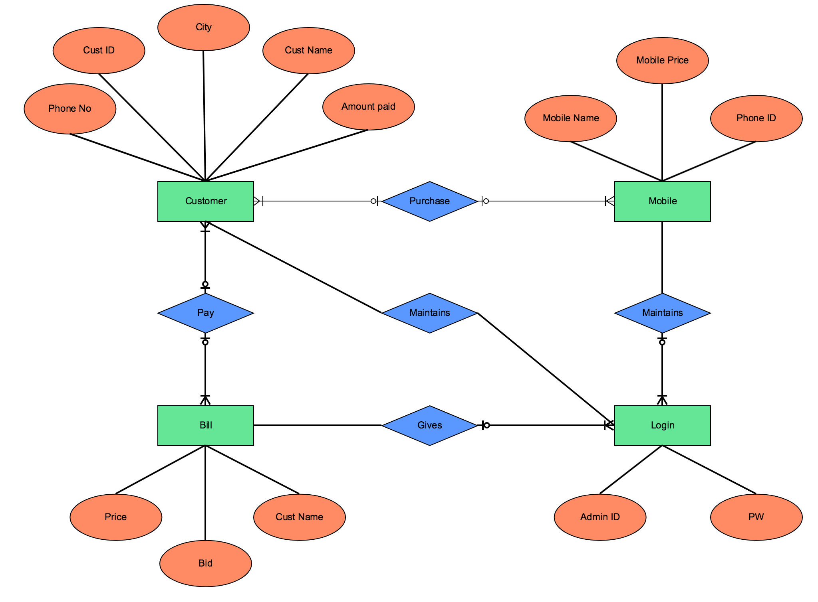
ERD 1 (Logical / Conceptual)
Notes:
You’ll notice the following in this diagram: Entities are the Rectangles
Attributes are the Circles
Relationships are the Diamonds – notice that they are Verbs.

Slide 10
ERDs (Logical / Conceptual)
Stage: Conceptual or Logical Design
Audience: Business stakeholders, analysts, and designers
Purpose: To provide a high-level, abstract view of the data model, focusing on entities and how they relate to each other.
Components:
Entities: Represent real-world objects or concepts.
Relationships: Show how entities interact with each other.
Attributes: Qualities or characteristics of entities (sometimes included).
Advantages:
Easier for non-technical stakeholders to understand.
Provides a foundation for the physical design.

Slide 11
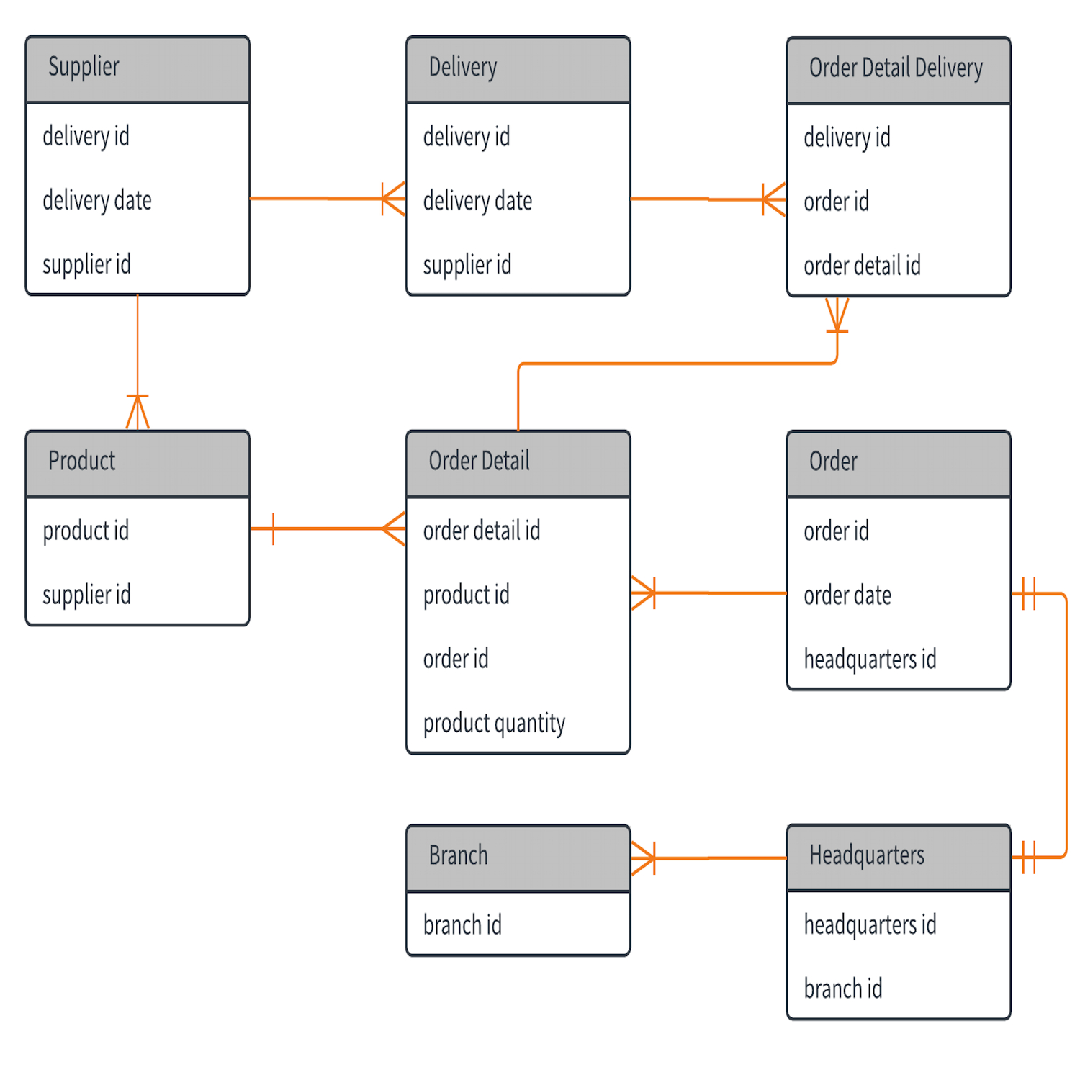
ERD (Physical)
Notes:
LINES! There are LINES!
These types of lines are Chen’s Notation
Entity–relationship model - Wikipedia

Slide 12
ERDs (Physical)
Stage: Physical Design
Audience: Database administrators, developers
Purpose: To provide a detailed, implementation-focused view that can be directly translated into database tables.
Components:
Tables: Correspond to entities in the logical model.
Columns: Correspond to attributes in the logical model.
Keys: Primary and foreign keys to establish relationships.
Advantages:
Provides a clear roadmap for database creation.
Includes specific details like data types, constraints, etc.

Slide 13
Many-to-Many Relationships
What is a Many-to-Many Relationship?
Examples
A Student has many courses and
A Course has many students.
A parent has many Children and A child can have multiple parents.
Resolving Many-to-Many Relationships
Resolving this type of relationship requires additional entities or tables. Databases do NOT support Many-To-Many relationships.
Notes:
Many-to-Many relationships involve multiple records in both tables.
Examples could be 'Students' and 'Courses'.
Use associative entities to represent in ERD.

Slide 14
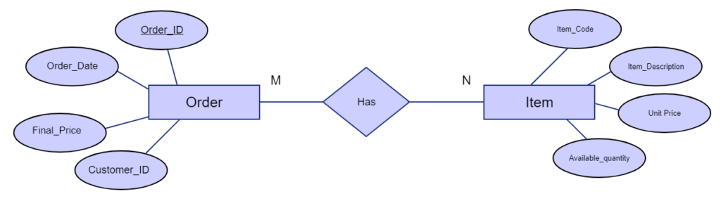
Many to Many Example
Notes:
You’ll notice the following in this diagram: Entities are the Rectangles
Attributes are the Circles
Relationships are the Diamonds – notice that they are Verbs.

Slide 15
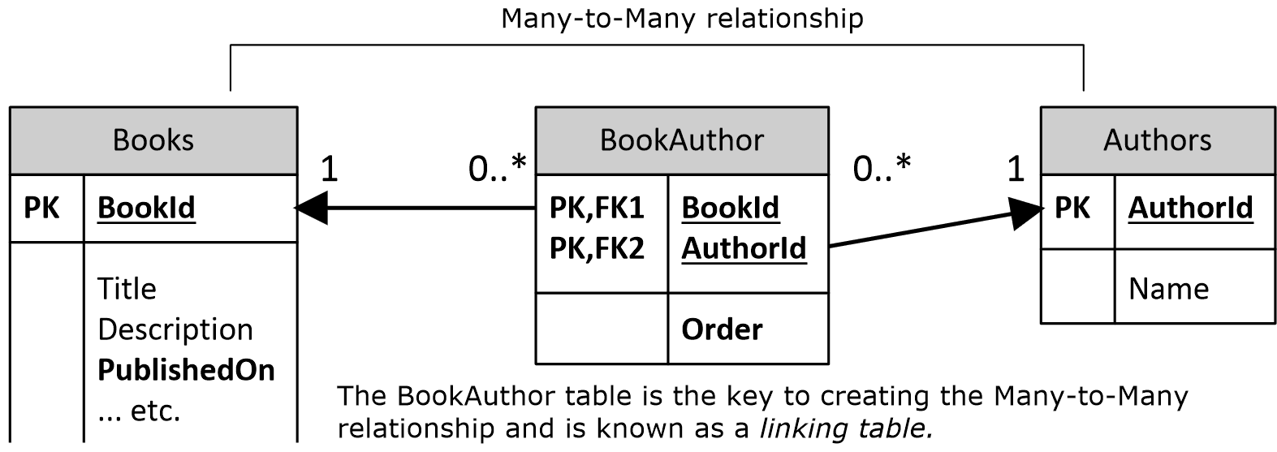
Many to Many Relationship
Notes:
You’ll notice that the Entity resolving the Many-To-Many relationship has a different type of Primary Key – this is considered a composite key – when multiple columns make up the primary Key.

Slide 16
Normalizing Databases
What is Database Normalization?
Normalization is the process of reducing data redundancy in a table and improving data integrity
The Process of organizing data in a proper manner.
Why Normalize a Database?
Improve data distribution
Better Designs
Improved Speed, accuracy and efficiency of the database.
Removal of Duplicate Data
(lots more)
Steps to Normalize
There are multiple normal forms for a database (1NF, 2NF, 3NF, etc.)
We’re going to focus on 1NF and 2NF
Notes:
Database Normalization is the process of organizing data to reduce redundancy and improve data integrity.
Discuss the benefits of normalization, such as easier updates and queries.
Walk through the steps of normalization, including 1NF, 2NF, 3NF, etc.
A relation is considered in 1NF if every domain attribute consists of one atomic or indiscreet value. it’s a really important property of a relationship that’s accessible within the RDBMS.
A relation is in 2NF only if it is in 1NF also as all the non-key attributes in the tables are addicted to the table’s primary key. this type applies to those relations that are connected using composite keys. The relation of the tables is coupled with a key that is composed of over one attribute.
A relation is in 3NF if and only if it’s in 2NF and there’s no transition dependency.
The main use of normalization is to utilize in order to remove anomalies that are caused because of the transitive dependency. Normalization is to minimize the redundancy and remove Insert, Update and Delete Anomaly. It divides larger tables into smaller tables and links them using relationships.

Slide 17
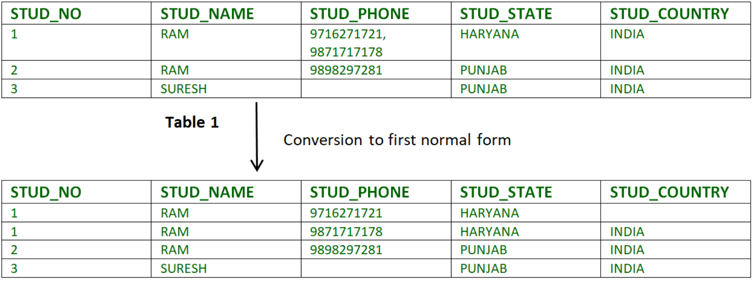
First Normal Form
Notes:
Table 1 is not normalized because there are mult-valued attributes in the STUD_PHONE column.
After normalization you can see that there are no longer multiple values per column.
As you can see, First Normal Form does not reduce Redundancy. It removes repeating groups. This isn’t the best to look at when you look at a Student table, you wouldn’t want to see duplicates like this. This is where Second Normal Form takes place.

Slide 18
Turn it into 2NF
Notes:
Split the screen, show Draw.IO. Work through how to turn this into 2NF.

Slide 19
Example Time

